Slide 1
SURE TRUST
Course name : G1 INTEGRATED VLSI INTERNSHIP
ANALOG MIXED SIGNALS

Slide 2
DESIGN OF SINGLE STAGE DIFFERENTIAL AMPLIFIER IN CADENCE

Slide 3
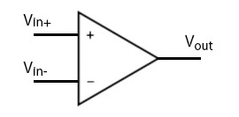
DIFFERENTIAL AMPLIFIER :
Definition
A differential (or difference) amplifier is a two-input circuit that amplifies only the difference between its two inputs. An operational amplifier or op-amp (Figure 1) is an example of a difference amplifier. The formula that describes the behavior of the circuit is:
Vout = A * (Vin+ - Vin-) where A is the gain of the amplifier

Slide 4
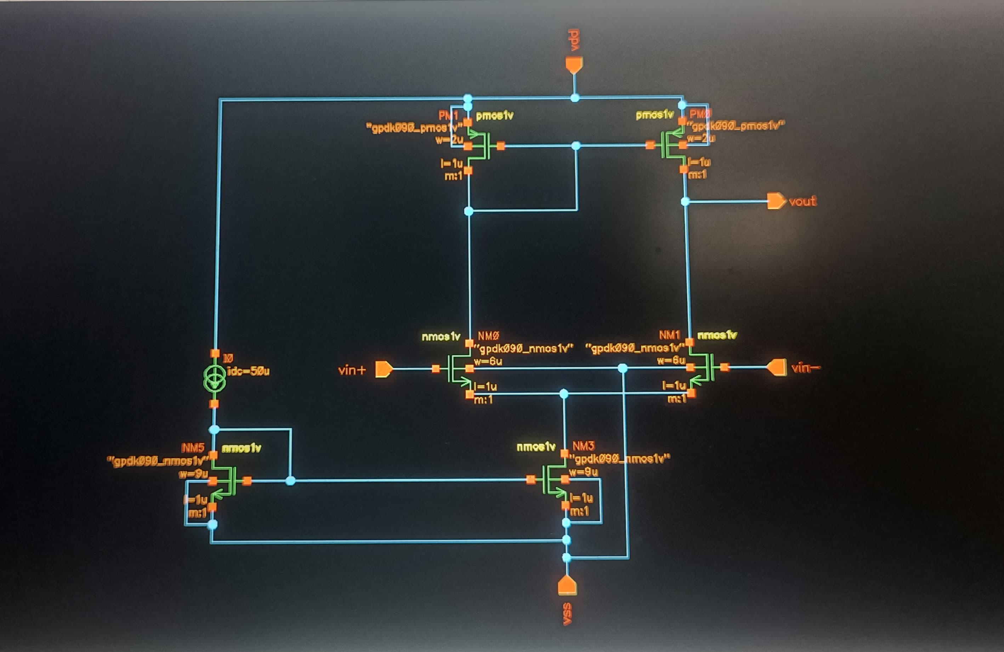
Diagram

Slide 5
Requirements :
Vdd = 1.8v
Av >= 100 ,40db
C = 10pF
ICMR+ = 1.4v
ICMR- = 0.8v
Slew Rate = 5v/u
(w/l)1,2 =7u
(w/l)3,4 =2u
(w/l)5,8 =9u
Power < 3mW
GB >= 5MHz

Slide 6
Design
Note : To design differential amplifier all mosfet’s should be in saturation region.
1.Finding the current from slew rate
S.R=dV0/dt
(“dVc/dt=I0/CL”)
Vc=V0
S.L=I0/CL
(5v/u)*CL=I0
I0= 50uA

Slide 7
2.Finding the (W/L) ratios of m3,m4 MOSFET’S using ICMR+
Vds>= Vgs - Vth
Vd >= Vg - Vt
Vx >= Vin – Vt
(Vin=ICMR+)
Vx>= 1.6 – 0.45
Vx >=1.15
Vx =1.2v
Vds of m3 MOSFET
Vds3 = Vdd – Vx
Vds3 = Vdd -1.2v
Vds3 = 1.8 – 1.2
Vds3 = 0.6v

Slide 8
The beta values of NMOS,PMOS are
B(NMOS) = 315u
B(PMOS) = 160u
Threshold voltages of NMOS,PMOS
Vth(p)=0.16v
Vth(n)= 0.18
From current equation
I=(upCox/2)(W/L)(Vgs – Vth)^2
We Know that I3=I0/2
25uA=(160u/2)(W/L)(0.6 -0.16)^2
25=(80)(W/L)(0.44)^2
(W/L)3,4=1.6u

Slide 9
Pole p2 at output side
V0=-gmVin(1/SCL)(ro3||ro4)/(1/SCL)+( ro3||ro4)
V0/Vin=-gm(1/SCL)(ro3||ro4)/1+SCL( ro3||ro4)
Pole(p)=1/(ro3||ro4)CL
Finding gm of m1 and m2 using GB(gain bandwidth)
GB=DC gain *P
GB=gm/SCL
GB=gm/2*pi*CL
5MHz=gm/2*pi*CL
gm 1,2 =314.16u
we know that dI/dv=gm
Finding (W/L)1,2 ratios using current equation and gm 1,2
I=(unCox/2)(W/L)(Vgs – Vth)^2
dI/dV = gm = unCox(W/L)(Vgs – Vth)

Slide 10
gm^2 = 2Id*un*Cox(W/L)
(W/L)=gm^2/2*I*uCox
(W/L)=(314.16)^2/2*25u*314.1
(W/L)1,2=6.215
(W/L)1,2=7
Finding (W/L)5,8 using ICMR-
Vin > Vgs1 + Vdsat
0.8 > Vgs1 + Vdsat
Vgs = ?
From Id
I=(unCox/2)(W/L)(Vgs – Vth)^2
25u=(315u/2)*(7)*((Vgs – Vth)^2)
0.514= Vgs1-0.45
Vgs1 = 0.6v

Slide 11
0.8 > 0.6 + Vdsat
Vdsat <= 0.2
I=(unCox/2)(W/L)(Vdsat)^2
50u=(315u/2)(W/L)(0.2)^2
(W/L)5,8=8.59
(W/L)5,8=9
Now we know all the values so, now we can design in cadence.

Slide 12
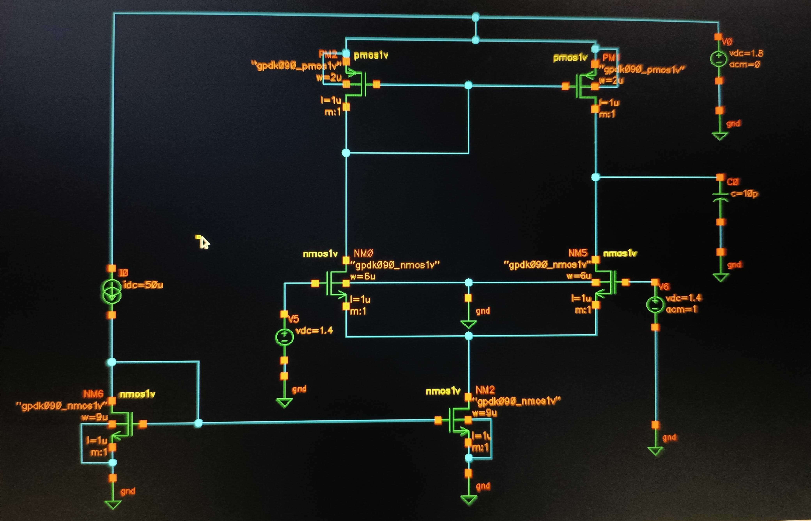
Test model :

Slide 13
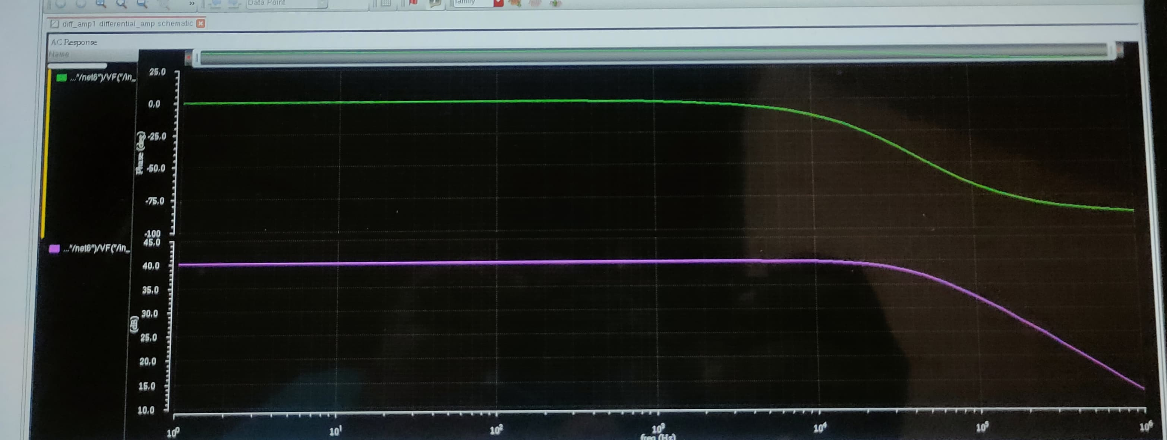
Out put wave forms:
Gain and phase plot :
Gain : 40dB
Phase : 0 degrees

Slide 14
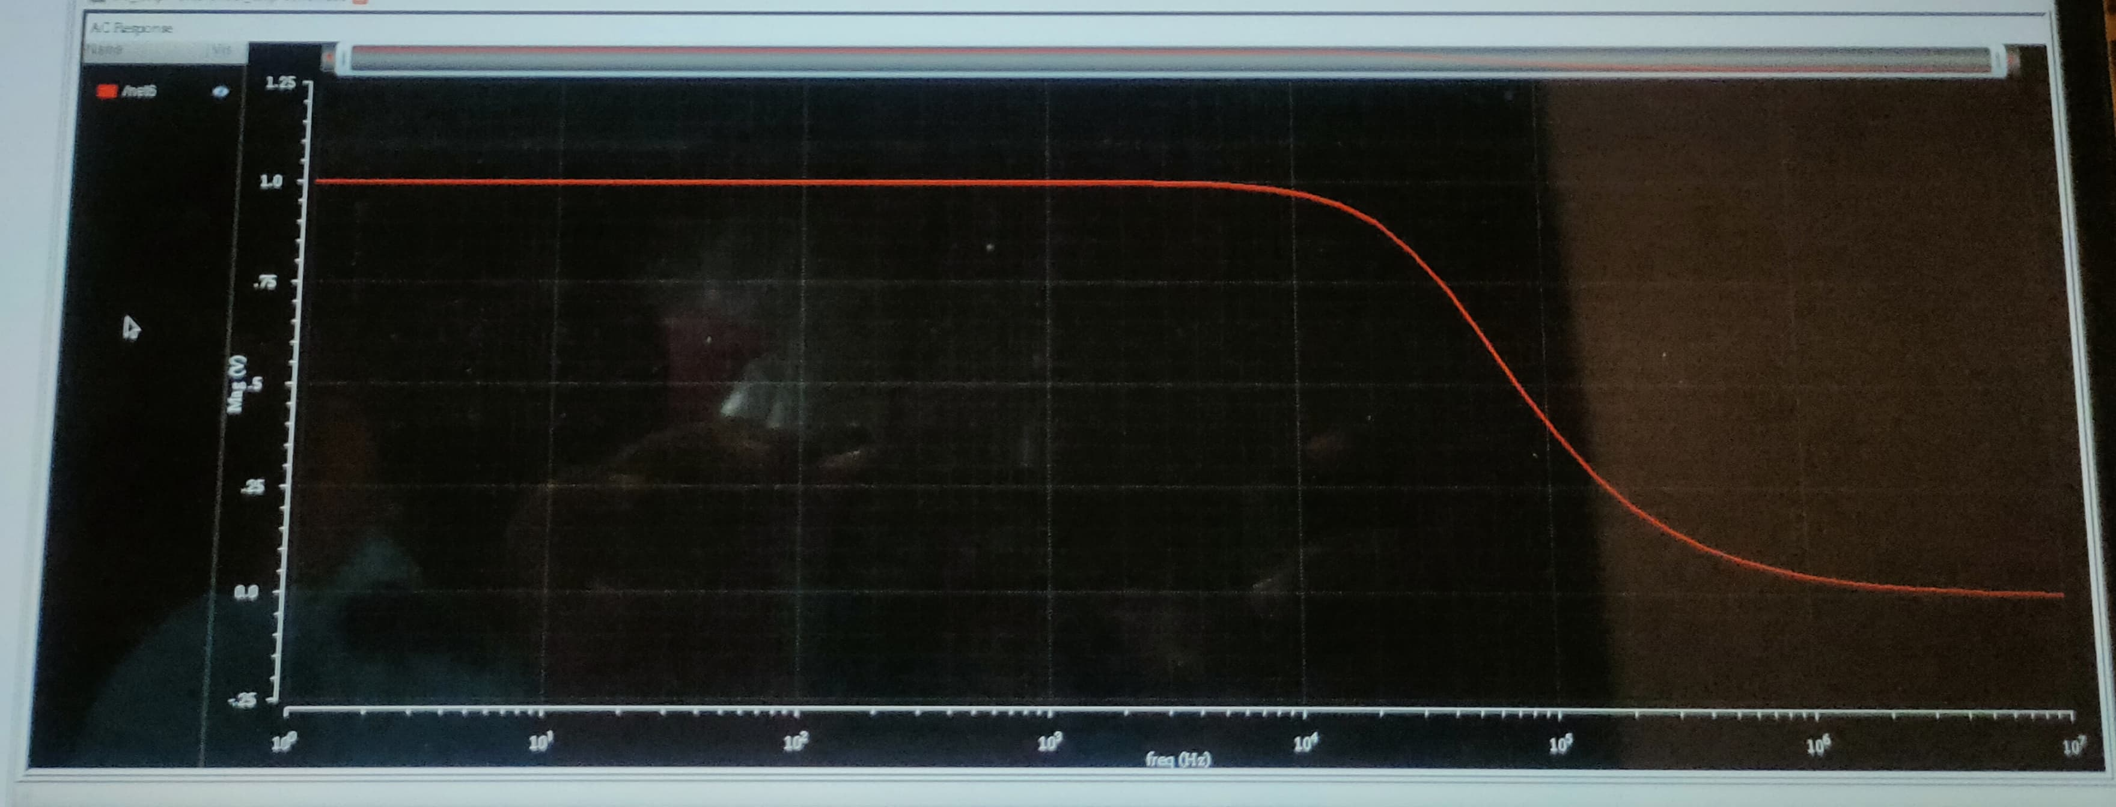
Power supply rejection ratio (PARR) :

Slide 15
Conclusion : In the design of a single-stage amplifier using Cadence, achieving the desired gain, phase margin, and Power Supply Rejection Ratio (PSRR) is crucial. Through iterative simulations and optimizations, the amplifier's gain is tailored to meet the required levels, ensuring a stable and robust performance. The phase margin is carefully adjusted to maintain stability and prevent oscillations. Additionally, the PSRR is optimized to minimize the influence of power supply variations on the amplifier's output, enhancing its reliability in various operating conditions. The resulting design meets the specified criteria, ensuring high performance and stability in practical applications.

